Slide 1
Project 2 – Aviation Accidents & Incidents
Project Tracks
A custom “creative” D3.js project (i.e., a nonstandard graph or chart)
Combination of Web-scraping and Leaflet
Combination of Web-scraping and Plotly
Dashboard page in HTML
Multiple Charts update from dataset
visualization should ideally include at least three views
include some level of user-driven interaction (e.g., menus, dropdowns, textboxes).
Team Members
Daniel Murchison
Edith Jimenez Mendez
Jin Dai
Michael Gonzalez
Mike Sammis
Database options:
a data set with at least 100 records
SQL
MongoDB
SQLite

Slide 2
Headers – Landing Page
Home
Map
Charts
Data
What's New
Second Headers Navigation – Map/Charts/etc.
C1
C2
C3
C4
Map
Charts
Data
What’s New
Chart
Map
Data
What’s New
Data
Chart
Map
What’s New
What’s New
Chart
Map
Data
Footer
Aviation Events

Slide 3
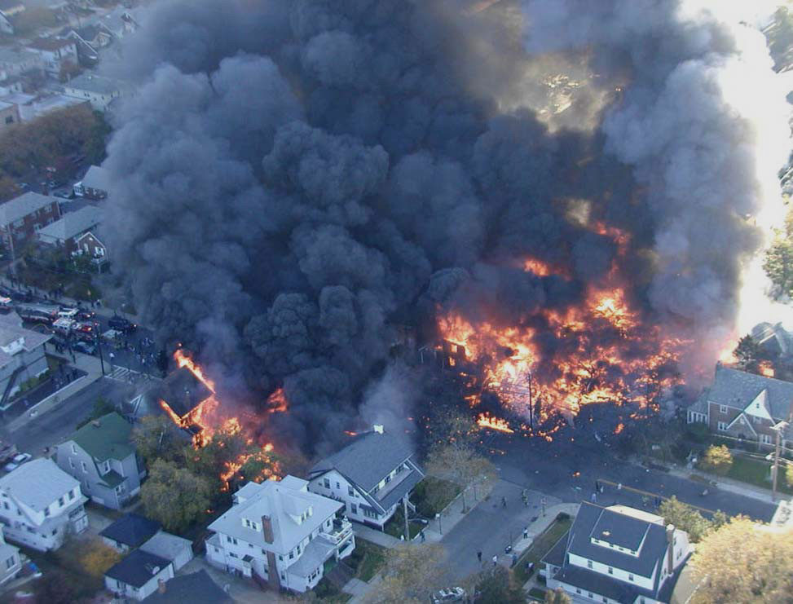
Landing Page – Content
Home
Map
Charts
Data
What's New
Project Scope
<p What:
Evaluate aviation accidents and incidents in the last 20 years at global level./p>
<p Why:
Pellentesque habitant morbi tristique senectus et netus et malesuada fames ac turpis egestas. Vestibulum tortor quam,.
/p>
<p how:
Pellentesque habitant morbi tristique senectus et netus et malesuada fames ac turpis egestas. Vestibulum tortor quam, /p>
<p Which:
Yyyyyyyyyyyyyyyyyyyyyy /p>
<p When:
Xxxx /p>
American Airlines Flight 587 was a regularly scheduled international passenger flight from John F. Kennedy International Airport to Las Américas International Airport in Santo Domingo, the capital of the Dominican Republic Nov 12 2001
Write some statement about worst event
Dataset of 500 cities (source data)
Max Temperature, Humidity, Cloudiness, and Wind Speed visualization and results.
Cities on Southern and Northern hemisphere comparison.
Aviation Events

Slide 4
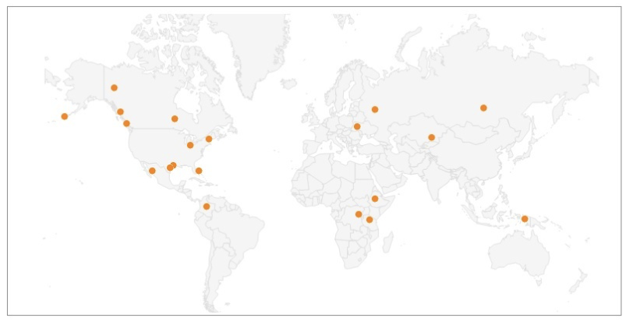
Chart– Map : Number of Events
Map
Charts
Data
What’s New
Total Injured
Build a dropdown menu to select the injury chart
Event Location latitude longitude
Add:
Markers
Tooltip

Slide 5
Charts – Aviation Event by Injuries
Chart
Map
Data
What’s New
Total Fatal Injuries
Total Serious Injuries
Total Minor Injuries
Total Injured
Build a dropdown menu to select the injury chart
Pellentesque habitant morbi tristique senectus et netus et malesuada fames ac turpis egestas. Vestibulum tortor quam, feugiat vitae, ultricies eget, tempor sit amet, ante. Donec eu libero sit amet quam egestas semper. Aenean ultricies mi vitae est. Mauris placerat eleifend leo.
Pellentesque habitant morbi tristique senectus et netus et malesuada fames ac turpis egestas. Vestibulum tortor quam, feugiat vitae, ultricies eget, tempor sit amet, ante. Donec eu libero sit amet quam egestas semper. Aenean ultricies mi vitae est. Mauris placerat eleifend leo.
Pellentesque habitant morbi tristique senectus et netus et malesuada fames ac turpis egestas. Vestibulum tortor quam, feugiat vitae, ultricies eget, tempor sit amet, ante. Donec eu libero sit amet quam egestas semper. Aenean ultricies mi vitae est. Mauris placerat eleifend leo.

Slide 6
Charts – Aviation Event by Injuries
Chart
Map
Data
What’s New
Total Fatal Injuries
Total Serious Injuries
Total Minor Injuries
Total Injured
Build a dropdown menu to select the injury chart
Pellentesque habitant morbi tristique senectus et netus et malesuada fames ac turpis egestas. Vestibulum tortor quam, feugiat vitae, ultricies eget, tempor sit amet, ante. Donec eu libero sit amet quam egestas semper. Aenean ultricies mi vitae est. Mauris placerat eleifend leo.
Pellentesque habitant morbi tristique senectus et netus et malesuada fames ac turpis egestas. Vestibulum tortor quam, feugiat vitae, ultricies eget, tempor sit amet, ante. Donec eu libero sit amet quam egestas semper. Aenean ultricies mi vitae est. Mauris placerat eleifend leo.
Pellentesque habitant morbi tristique senectus et netus et malesuada fames ac turpis egestas. Vestibulum tortor quam, feugiat vitae, ultricies eget, tempor sit amet, ante. Donec eu libero sit amet quam egestas semper. Aenean ultricies mi vitae est. Mauris placerat eleifend leo.

Slide 7
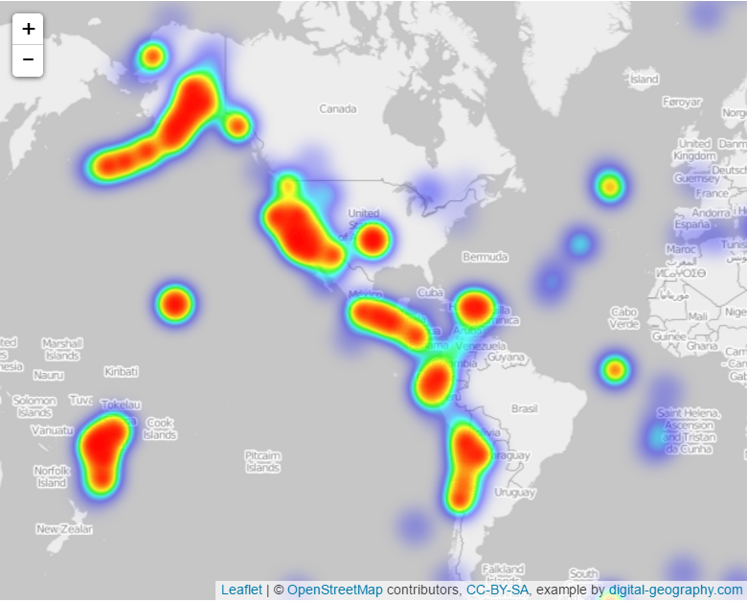
Charts – Aviation Event by Injuries
Chart
Map
Data
What’s New
Total Fatal Injuries
Total Serious Injuries
Total Minor Injuries
Total Injured
Heat map
Build a dropdown menu to select the injury chart
Pellentesque habitant morbi tristique senectus et netus et malesuada fames ac turpis egestas. Vestibulum tortor quam, feugiat vitae, ultricies eget, tempor sit amet, ante. Donec eu libero sit amet quam egestas semper. Aenean ultricies mi vitae est. Mauris placerat eleifend leo.
Pellentesque habitant morbi tristique senectus et netus et malesuada fames ac turpis egestas. Vestibulum tortor quam, feugiat vitae, ultricies eget, tempor sit amet, ante. Donec eu libero sit amet quam egestas semper. Aenean ultricies mi vitae est. Mauris placerat eleifend leo.
Pellentesque habitant morbi tristique senectus et netus et malesuada fames ac turpis egestas. Vestibulum tortor quam, feugiat vitae, ultricies eget, tempor sit amet, ante. Donec eu libero sit amet quam egestas semper. Aenean ultricies mi vitae est. Mauris placerat eleifend leo.

Slide 8
Charts – Aviation Event by Injuries
Chart
Map
Data
What’s New
Total Fatal Injuries
Total Serious Injuries
Total Minor Injuries
Total Injured
Time_Keeps_On_Ticking
Build a dropdown menu to select the injury chart
Pellentesque habitant morbi tristique senectus et netus et malesuada fames ac turpis egestas. Vestibulum tortor quam, feugiat vitae, ultricies eget, tempor sit amet, ante. Donec eu libero sit amet quam egestas semper. Aenean ultricies mi vitae est. Mauris placerat eleifend leo.
Pellentesque habitant morbi tristique senectus et netus et malesuada fames ac turpis egestas. Vestibulum tortor quam, feugiat vitae, ultricies eget, tempor sit amet, ante. Donec eu libero sit amet quam egestas semper. Aenean ultricies mi vitae est. Mauris placerat eleifend leo.
Pellentesque habitant morbi tristique senectus et netus et malesuada fames ac turpis egestas. Vestibulum tortor quam, feugiat vitae, ultricies eget, tempor sit amet, ante. Donec eu libero sit amet quam egestas semper. Aenean ultricies mi vitae est. Mauris placerat eleifend leo.

Slide 9
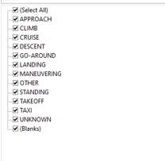
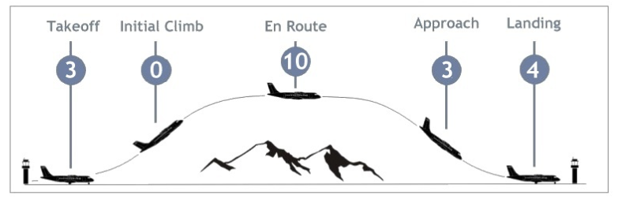
Chart – Event by Broad Phase of flight
Chart
Map
Data
What’s New
Total Event
Build a dropdown menu to select phase??? I am not sure about this drop down menu
Phases
Cruise

Slide 10
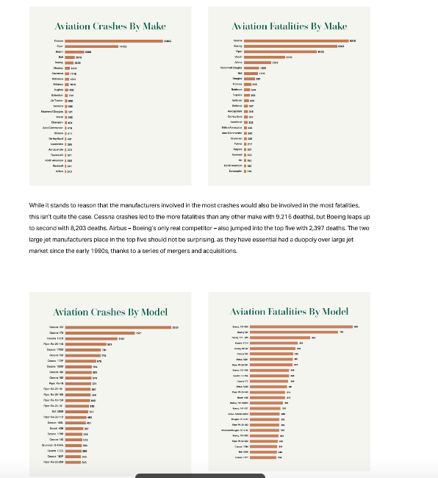
Chart – Event by country or Make or Model ??
Chart
Map
Data
What’s New
Total Fatal Injuries
Total Serious Injuries
Total Minor Injuries
Total Injured
Pellentesque habitant morbi tristique senectus et netus et malesuada fames ac turpis egestas. Vestibulum tortor quam, feugiat vitae, ultricies eget, tempor sit amet, ante. Donec eu libero sit amet quam egestas semper. Aenean ultricies mi vitae est. Mauris placerat eleifend leo.
Pellentesque habitant morbi tristique senectus et netus et malesuada fames ac turpis egestas. Vestibulum tortor quam, feugiat vitae, ultricies eget, tempor sit amet, ante. Donec eu libero sit amet quam egestas semper. Aenean ultricies mi vitae est. Mauris placerat eleifend leo.
Pellentesque habitant morbi tristique senectus et netus et malesuada fames ac turpis egestas. Vestibulum tortor quam, feugiat vitae, ultricies eget, tempor sit amet, ante. Donec eu libero sit amet quam egestas semper. Aenean ultricies mi vitae est. Mauris placerat eleifend leo.

Slide 11
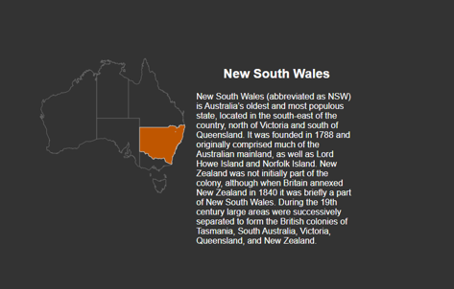
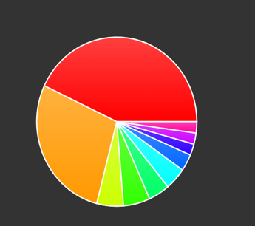
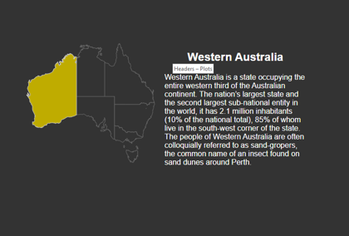

Chart – Event by country Australia??
What’s New
Chart
Map
Data
Space to try Raphaël (JavaScript library)
https://dmitrybaranovskiy.github.io/raphael/australia.html
https://dmitrybaranovskiy.github.io/raphael/chart.html
https://dmitrybaranovskiy.github.io/raphael/pie.html

Slide 12
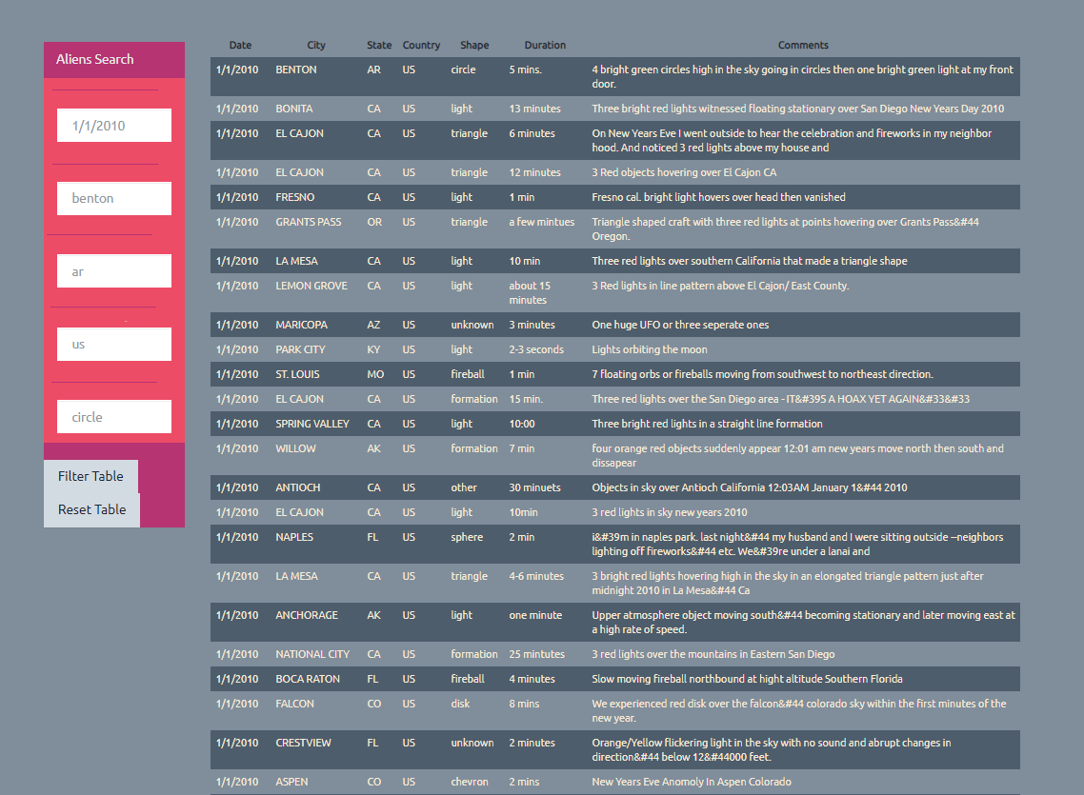
Data –
Total Fatal Injuries
Total Serious Injuries
Total Minor Injuries
Total Injured
Data
Chart
Map
What’s New
Date
Country
Make

Slide 13
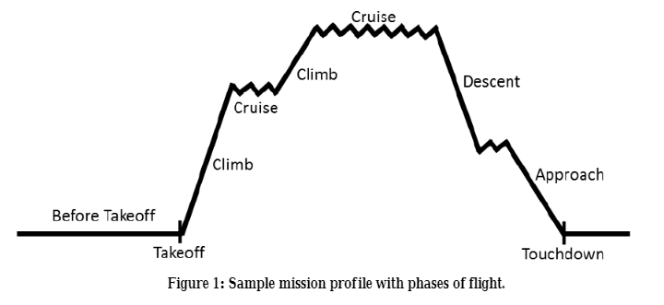
Write Notes Here
visual meteorological conditions (VMC)
instrument flight meteorological conditions (IMC)
Sequence of Broad Phase of Flight:
Standing (STD)
Pushback/Towing(PBT)
Taxi(TXI)
Takeoff(TOF)
Initial Climb(ICL) --- 1000ft
En Route (ENR)
- Climb to cruise
- Cruise
- Change Cruise level
- Descent
- Holding
Maneuvering (MNV)
Approach(APR)
- Missed approach → Go Around
Landing(LDG)
Unknown(UNK)
Broad Phase of Flight

Slide 14
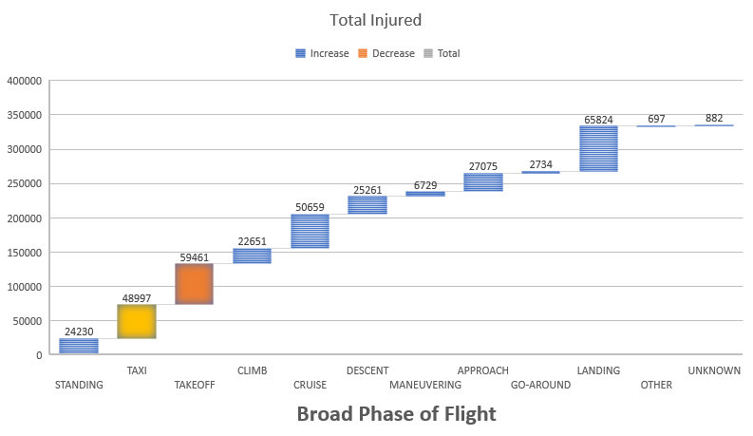
Chart – Event by country or Make or Model ??
Chart
Map
Data
What’s New
Total Fatal Injuries
Total Serious Injuries
Total Minor Injuries
Total Injured
Pellentesque habitant morbi tristique senectus et netus et malesuada fames ac turpis egestas. Vestibulum tortor quam, feugiat vitae, ultricies eget, tempor sit amet, ante. Donec eu libero sit amet quam egestas semper. Aenean ultricies mi vitae est. Mauris placerat eleifend leo.
Pellentesque habitant morbi tristique senectus et netus et malesuada fames ac turpis egestas. Vestibulum tortor quam, feugiat vitae, ultricies eget, tempor sit amet, ante. Donec eu libero sit amet quam egestas semper. Aenean ultricies mi vitae est. Mauris placerat eleifend leo.
Pellentesque habitant morbi tristique senectus et netus et malesuada fames ac turpis egestas. Vestibulum tortor quam, feugiat vitae, ultricies eget, tempor sit amet, ante. Donec eu libero sit amet quam egestas semper. Aenean ultricies mi vitae est. Mauris placerat eleifend leo.

Slide 15
Chart – Event by country or Make or Model ??
Chart
Map
Data
What’s New
Total Fatal Injuries
Total Serious Injuries
Total Minor Injuries
Total Injured
Pellentesque habitant morbi tristique senectus et netus et malesuada fames ac turpis egestas. Vestibulum tortor quam, feugiat vitae, ultricies eget, tempor sit amet, ante. Donec eu libero sit amet quam egestas semper. Aenean ultricies mi vitae est. Mauris placerat eleifend leo.
Pellentesque habitant morbi tristique senectus et netus et malesuada fames ac turpis egestas. Vestibulum tortor quam, feugiat vitae, ultricies eget, tempor sit amet, ante. Donec eu libero sit amet quam egestas semper. Aenean ultricies mi vitae est. Mauris placerat eleifend leo.
Pellentesque habitant morbi tristique senectus et netus et malesuada fames ac turpis egestas. Vestibulum tortor quam, feugiat vitae, ultricies eget, tempor sit amet, ante. Donec eu libero sit amet quam egestas semper. Aenean ultricies mi vitae est. Mauris placerat eleifend leo.

